Slide 1
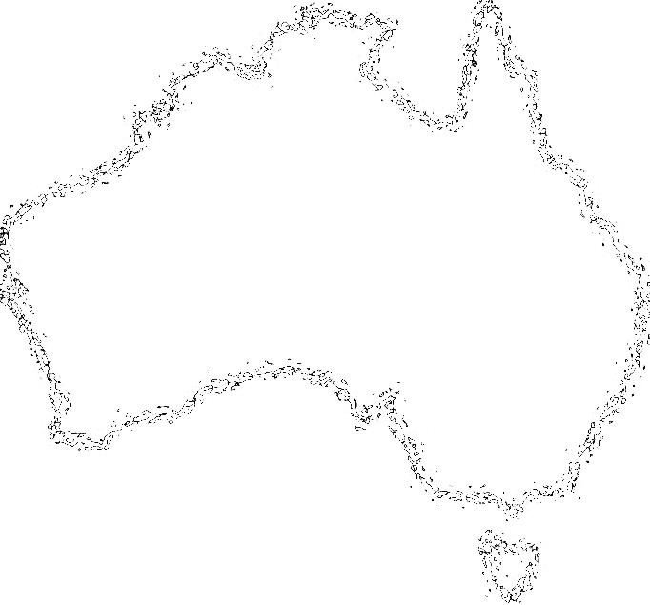
Can You Hear the Children
Marching?
An ANZAC song
By Nathan Cahill

Slide 2
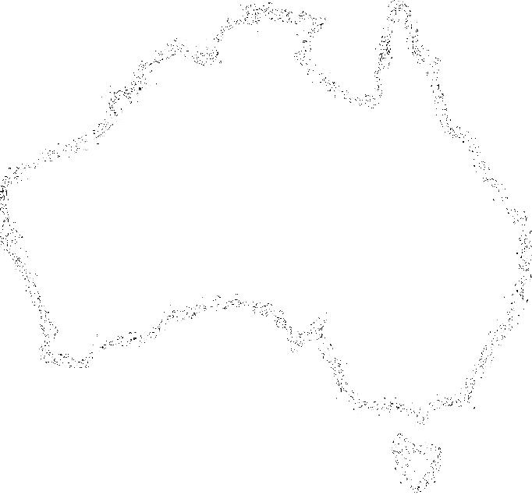
No more shall we see them,
those heroes of the war
Who gave the pride of ANZAC
to Australians one and all
But from the words "Dig in, boys",
beneath a foreign sun
A heritage of pride was born:
our legacy begun.

Slide 3
Since that first great crossing
against the treacherous swell
Our nation has remembered those who fought,
and those who fell.
And with the passing of the years,
their memory survives;
Through younger generations
our tradition stays alive.

Slide 4
And can you hear the children
marching 'cross Australia?
With voices echoing the strains:
"We will remember"
The years go on and on,
and still we answer to the call
To keep the flame eternal burning
brightly for us all,
And you will hear the children marching
all across Australia.

Slide 5
From north to south and east to west,
you'll see us hand in hand
From capital to country and
from shores to desert sands
We'll take this proud tradition,
and though our years are few
Together celebrate the freedom
bought for me and you

Slide 6
And can you hear the children
marching 'cross Australia?
With voices echoing the strains:
"We will remember"
The years go on and on,
and still we answer to the call
To keep the flame eternal burning
brightly for us all,
And you will hear the children marching
all across Australia.

Slide 7
And can you hear the children marching
All across Australia
With voices echoing, we’re marching
We will remember
Our generation will be marching
All across Australia
Together celebrate, we’re marching
North to south, and east to west

Slide 8
And you will hear the children marching
All across Australia.

